Slide 1
Major Components: Enterprise IT Network
Edge router
WAN interfaces
Edge filtering (access lists)
DDOS protection
NGN FW
Capable of APT attack prevention, malware filtering, web security, email security, application bandwidth filtering

Slide 2
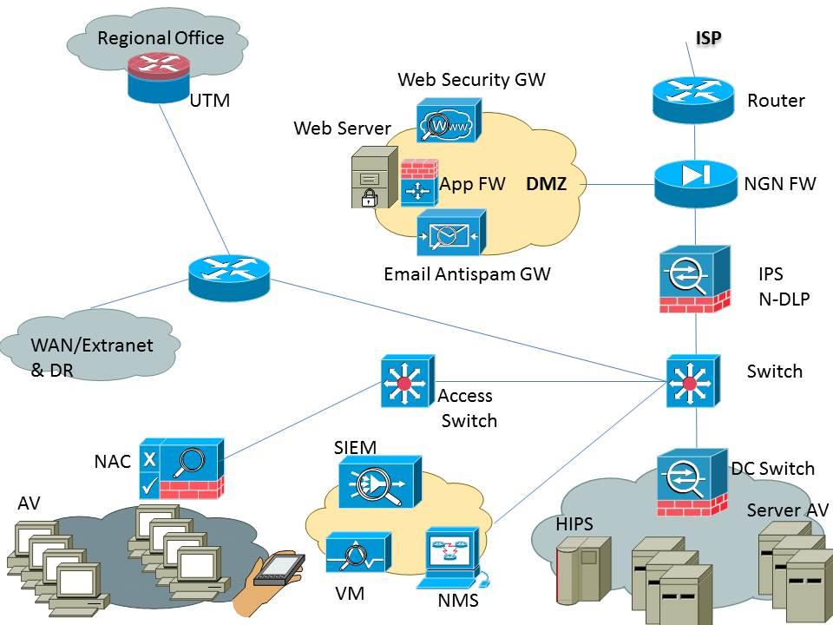
Major Components: Enterprise IT Network

Slide 3
Major Components: Enterprise IT Network
DMZ:
Security zone with placement of published web server, web & email security GWs, app security GW
IPS:
Intrusion prevention (signature based)
May be feature in NGN-FW

Slide 4
Major Components: Enterprise IT Network
Distribution switch
Connectivity to access switches, external exit point (WAN), and DC switch
Data center switch & FW
Data center filtering (malware & access-lists)

Slide 5
Major Components: Enterprise IT Network
Access switch
User connectivity
Switchport security & access switch security
NAC
Network admission control (IEEE802.1X)
SIEM
Logging & dashboard for events, root cause analysis, event correlation

Slide 6
Major Components: Enterprise IT Network
Vulnerability Manager
Vulnerability scanning and asset tracking
System AV
Signature based malware prevention
Server HIPS
IPS features for servers, also file integrity checking

Slide 7
Major Components: Enterprise IT Network
UTM
Multi-featured NGN FW device
Mobile device – MDM
Security features for mobile devices

